Slide 1
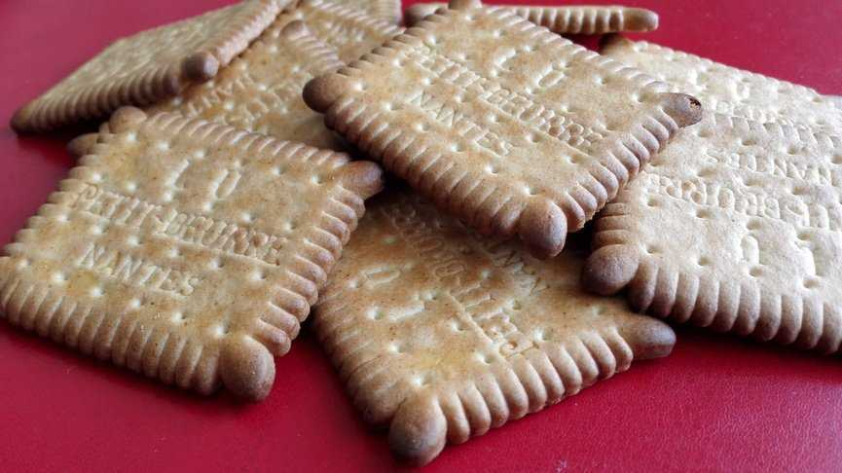
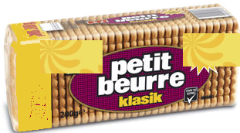
The Law of the Petit Beurre
The Statistical Journey of Broken Biscuits

Slide 2
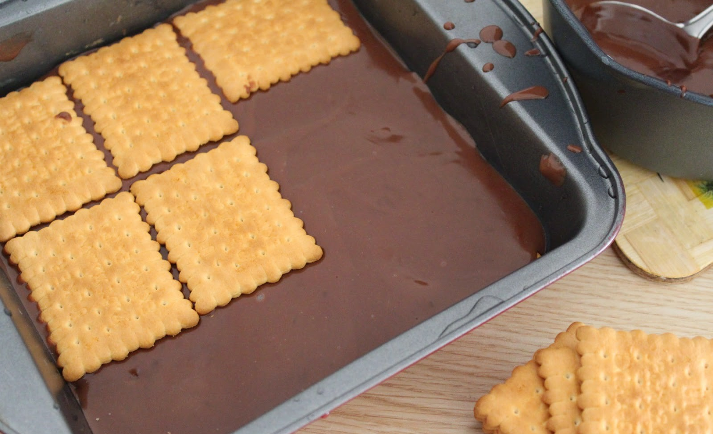
What is the Petit Beurre Law?
A look at the breakage probabilities of biscuits in a packet
The Petit Beurre's Law is a legal formula that explains that if the first biscuit in a packet is broken, the subsequent biscuits are also likely to be broken.
According to this law, each broken biscuit significantly increases the probability that subsequent biscuits will be broken.

Slide 3
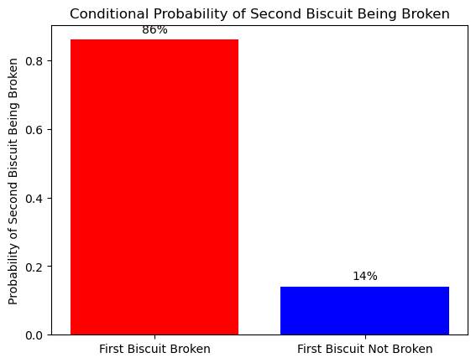
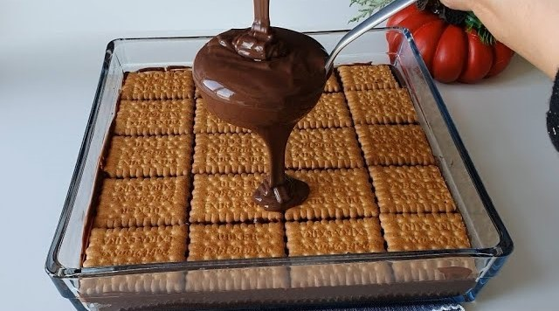
Statistical Probabilities : First Biscuit Broken
If the first biscuit in the packet is broken,
the second biscuit the probability of fracture is %86

Slide 4
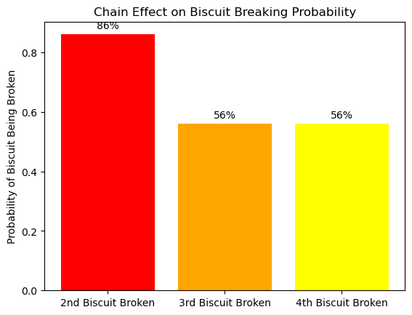
If the second biscuit is broken : Chain Effect
If the second biscuit is broken, the probability of breaking the third and fourth biscuits
increases to over %56. A chain effect occurs here.

Slide 5
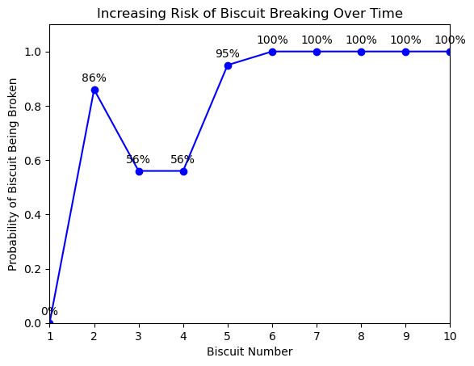
Crisis Point on the Fifth Biscuit
If the fifth biscuit is also broken, we can conclude that no biscuit is safe. This implies that
there is a high probability that the remaining biscuits in the pack will also be broken.

Slide 6

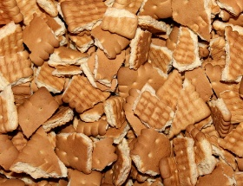
Insight and Results
If the fifth biscuit is also broken, we can conclude that no biscuit is safe. This implies that
there is a high probability that the remaining biscuits in the pack will also be broken.
Chain of Risk: The first broken biscuit in the pack dramatically increases the likelihood of the whole pack being broken.
Chain Effect: As the second and third biscuits break, the probability of breakage gradually increases.
Crisis Point: On the fifth biscuit, all biscuits are no longer safe.
% 50
Broken Biscuits
% 14
Increase Rate
% 100
Breakage

Slide 7
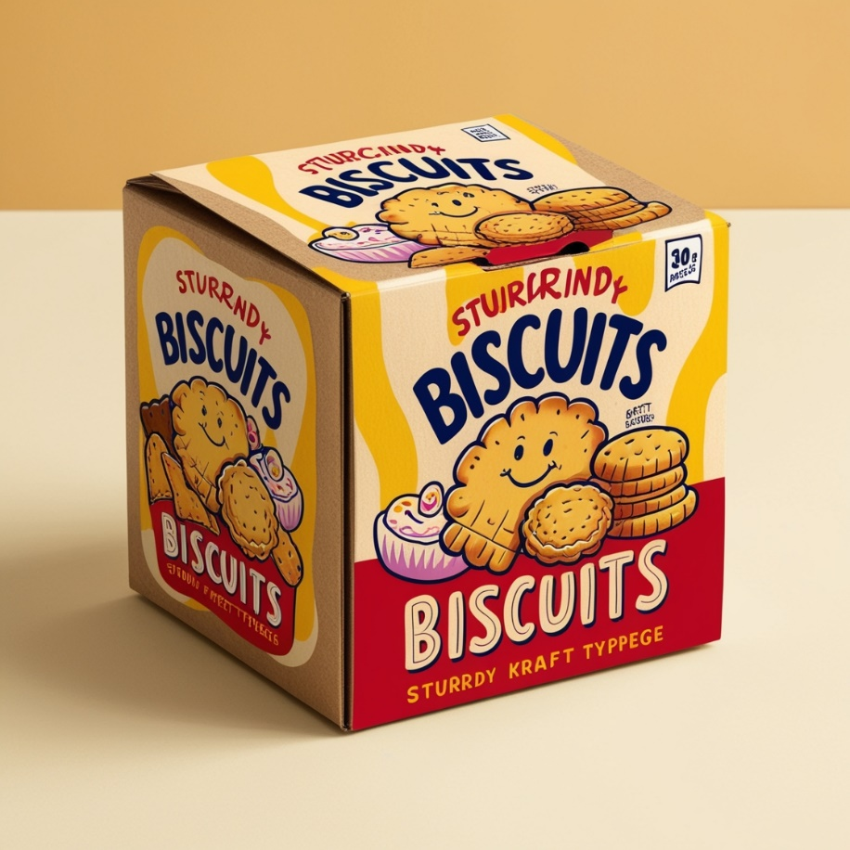
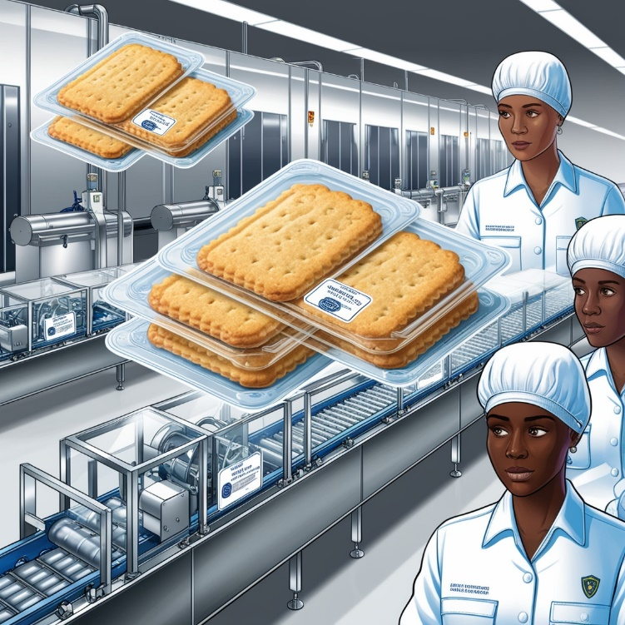
Closing and Solution Suggestions
Solutions to Prevent Biscuit Breakage
Increasing biscuit safety in the production and packaging phase.
Making packaging more durable.

